Slide 1
Particle Wafer Image Classification
Matthew Shull, Alexandra Barker, Maximillian Jacob, Akanksha Chattopadhyay
Notes:
Hello everyone, we are happy to share our project on particle wafer image classification, a critical aspect of semiconductor manufacturing.
Our goal is to develop a machine learning model that can accurately identify and classify defects on wafer maps, improving efficiency and product quality

Slide 2

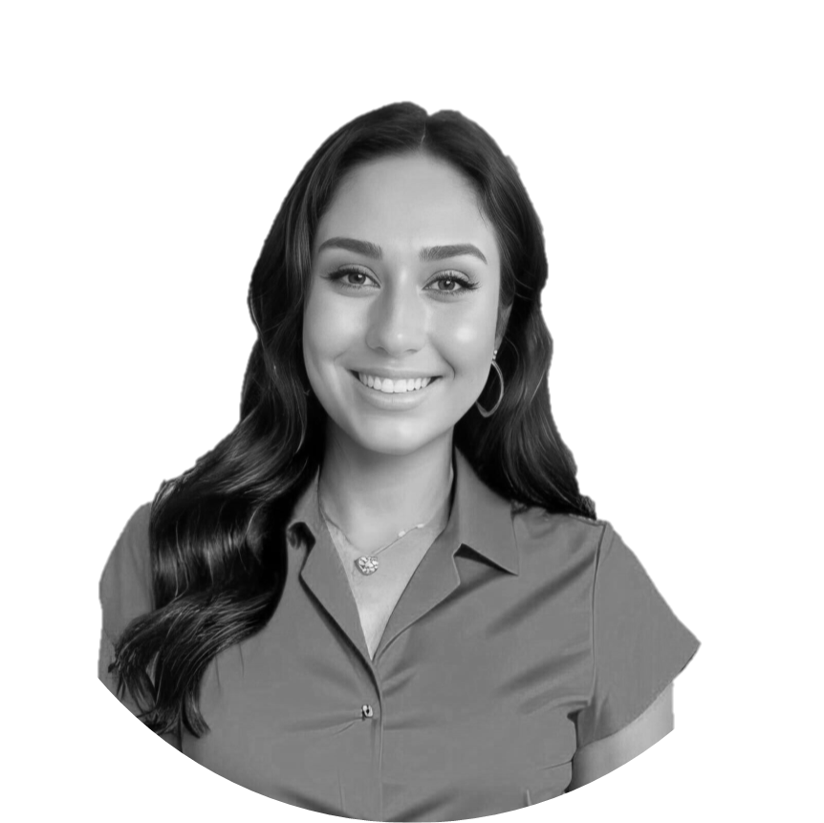

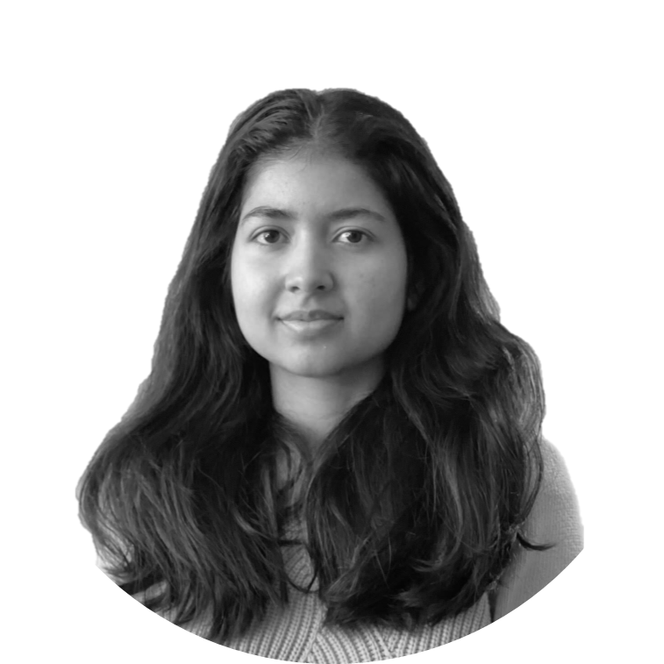
This is our team.
Alexandra
Matthew
He/Him
Max
Akanksha
Program Manager @ Lowe’s
Industrial Engineer @ Boeing
Module Engineer @ Intel
Data Scientist @
Johns Hopkins University’s Applied Physics Lab
Notes:
And this is our team,
Alexandra, Matthew, Akanksha, and myself

Slide 3
Table of Contents.
Background
Exploratory Data Analysis
Data Preprocessing
Model Development
01
02
03
04
Notes:
Here's an overview of our main discussion: we'll cover the background, EDA, data preprocessing, and model development.

Slide 4
Background.
01
Notes:
Max

Slide 5
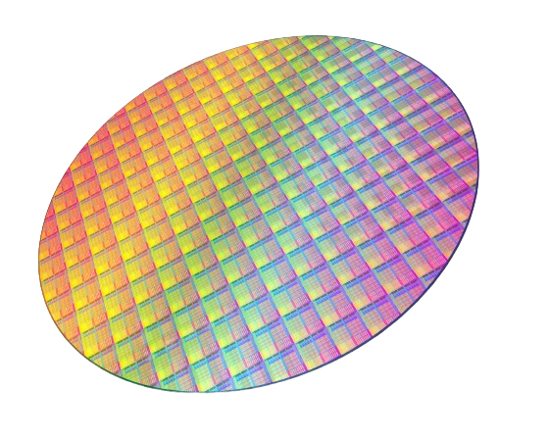

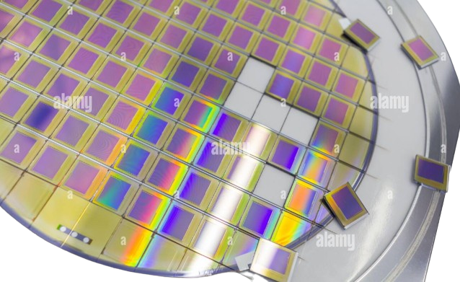


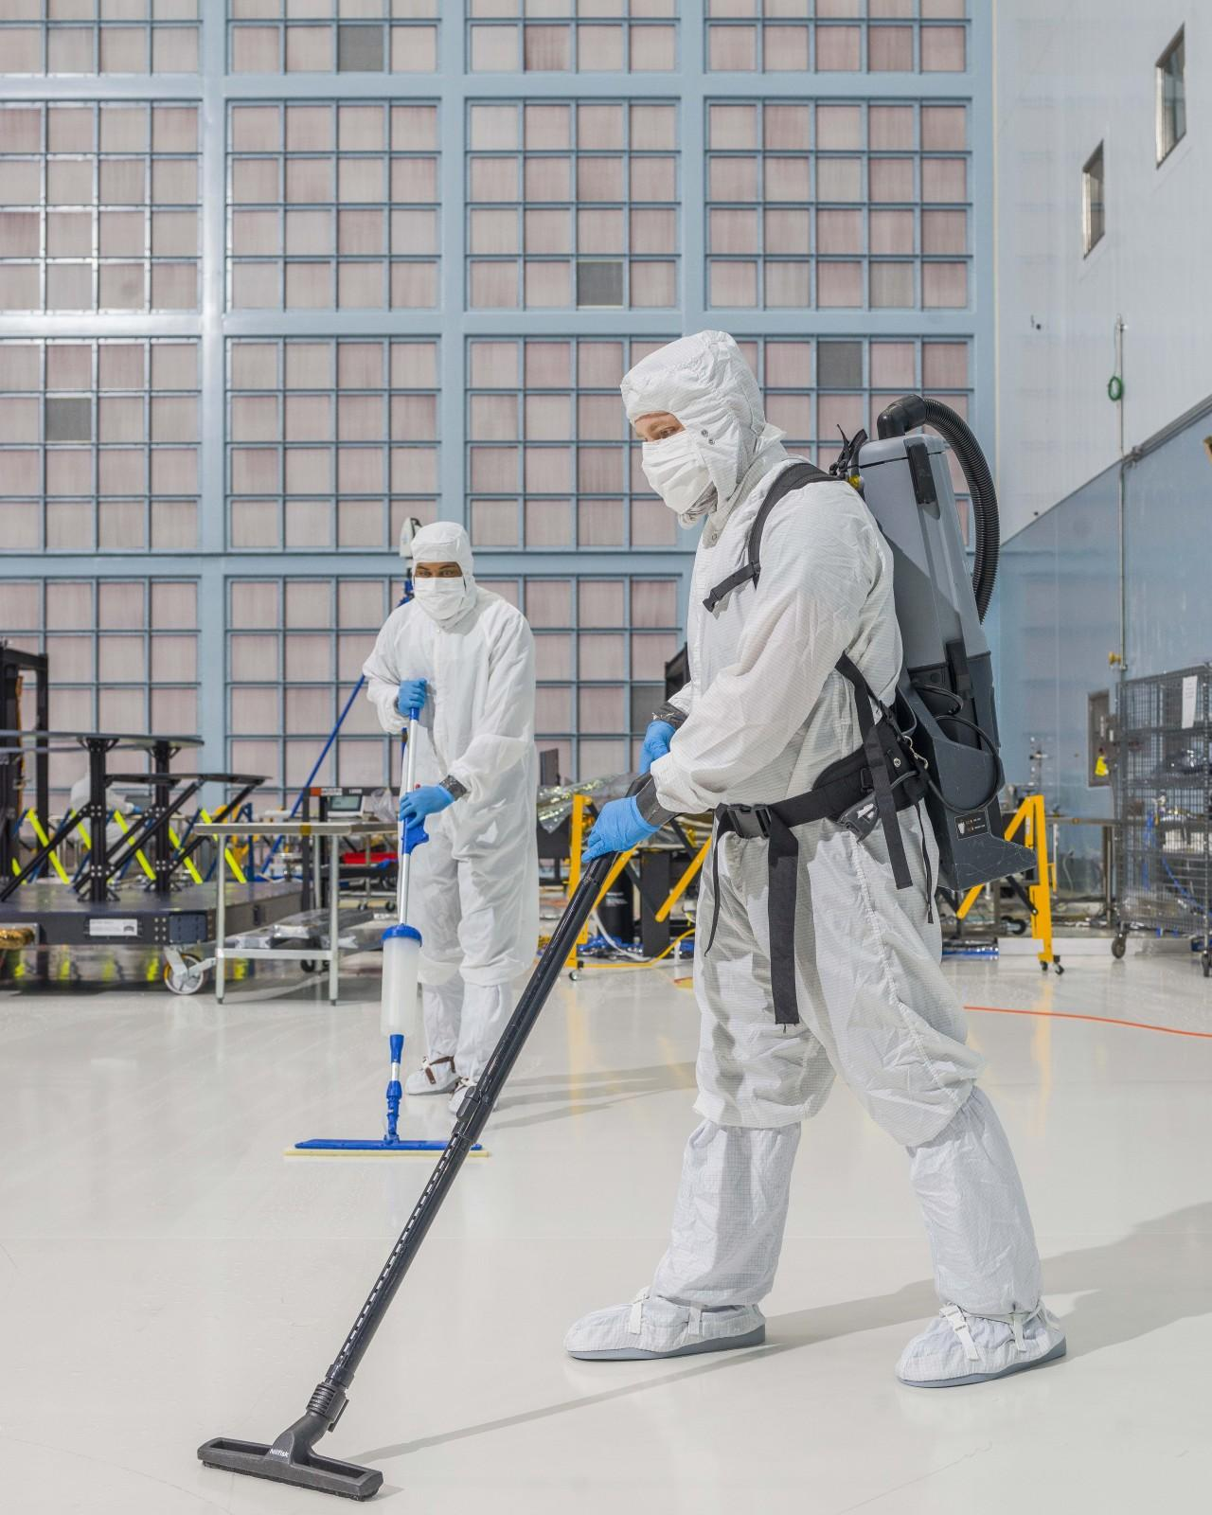

Semiconductor who??
Significance of semiconductor industry
Advancement in AI and machine learning
Importance of High-Quality Chips and Chiplets
Challenge of maintaining cleanliness in wafer processing and its impact to final quality
Notes:
Alright!! Semiconductor!
These tiny marvels are the backbone of the modern technology, powering everything from our smartphones to supercomputers.
Now, imagine a world without semiconductors..
That means.. no Netflix, no video games, and no-many things.
This industry is beyond significant, it’s the pulse of the tech world, and this is the key ingredient to drive innovation.
And of course I have throw the buzzword of the year..
AI, machine learning.
What does it have to do with semiconductors, you may think..
Well..
Alot.
AI chips, like GPUs.. TPUs, are specifically designed to handle the massive computation demands of AI tasks,
accelerating deep learning processes
enabling real-time decision-making.
On to our next point, the quest for high-quality chips and chiplets.
These are the gourmet ingredients in our tech recipes.
This is similar to how a top chef needs the best produce to create the best dish..
The tech industry needs top quality chips to deliver stellar performance.
High-quality chips mean faster processing, better energy efficiency, and ultimately an overall better user experience
Finally I would to discuss the challenge of maintaining the cleanliness in wafer processing.
Trying to maintain the cleanliness in this industry is akin to trying to bake a perfect cake in a dusty storm.
The tiniest particle can ruin the entire batch.
Now, imagine spending millions on a production line only to have it be compromised by a speck of dust..
This is the reality of the semiconductor industry.
It’s a massive challenge, and the impact on the final product can be huge.

Slide 6
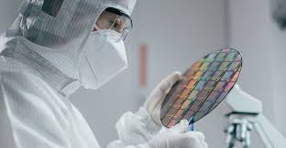

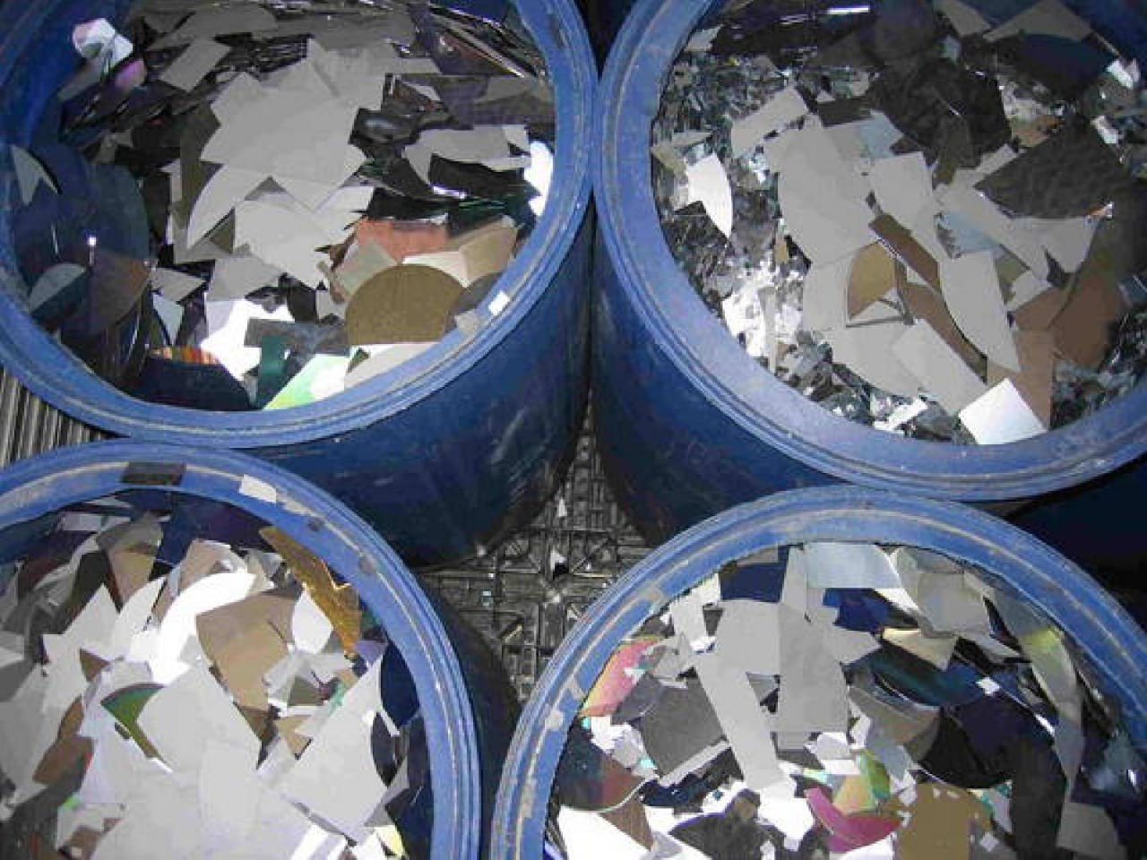
Current Solutions and Challenges!
Manual identification of particle patterns
Delayed detection and response
Impact on production wafers
Notes:
Current solutions and challenges!!
Right now, identifying particle patterns is a bit like playing detective..
Tech/Engineers manually inspect wafermaps to spot issues.
The corrective action kicks in only after a problem occurs at the end of the line, making it more reactive than proactive.
It’s labor-intensive,
prone to human error,
and..
Let’s face it.. Not the most efficient way to catch contamination early
Now,
Because we only catch these issues at the end of the processing line,
there’s a significant lag between when contamination happens and when we actually detect it.
This is problematic..
To put into perspective, that’s like finding out your ship has a leak only when you’re halfway across the ocean!
This delayed detection means that by the time we know there’s a problem, many wafers have already been compromised.
Finally, let’s look at the impact on our production wafers.
Ultimately, not only this reduces the yield of high-quality chips but also drives up costs.
Our goal with this project is to flip the script -
By using machine learning, we aim to detect potential patterns associated with certain defect modes as early as possible.
This way we can alert engineers immediately to take corrective action before the problem snowballs..
keeping our production lines running smoothly and efficiently.

Slide 7
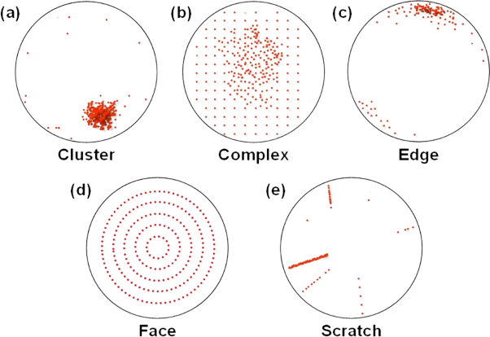
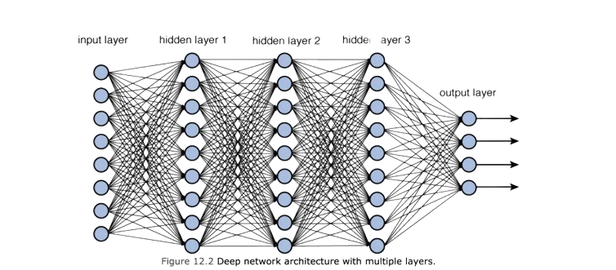

The Data Background.
Original dataset, WM-811K wafer map, found on Kaggle.
Defect types: Center, Donut, Edge-Loc, Edge-Ring, Loc, Random, Scratch, Near-full, and none.
Labelled data, supervised learning: Convolutional Neural Network
Notes:
Back to this project!
The Data Background!! For the data source, we utilized the WM-811K dataset which can be found on Kaggle.
This dataset includes various particle defect types such as Center, Donut, Edge-Loc, just to name a few.
Now, Because this data is labelled, this is an ideal opportunity for supervised learning.
Specifically we will be leveraging on the Convolutional Neural Network to train our model
Now I would like to pass to Matthew to discuss our EDA!

Slide 8
Exploratory Data Analysis.
02
Notes:
Matt
Thanks Max, we’ll be going into the Exploratory data analysis portion of our presentation.

Slide 9
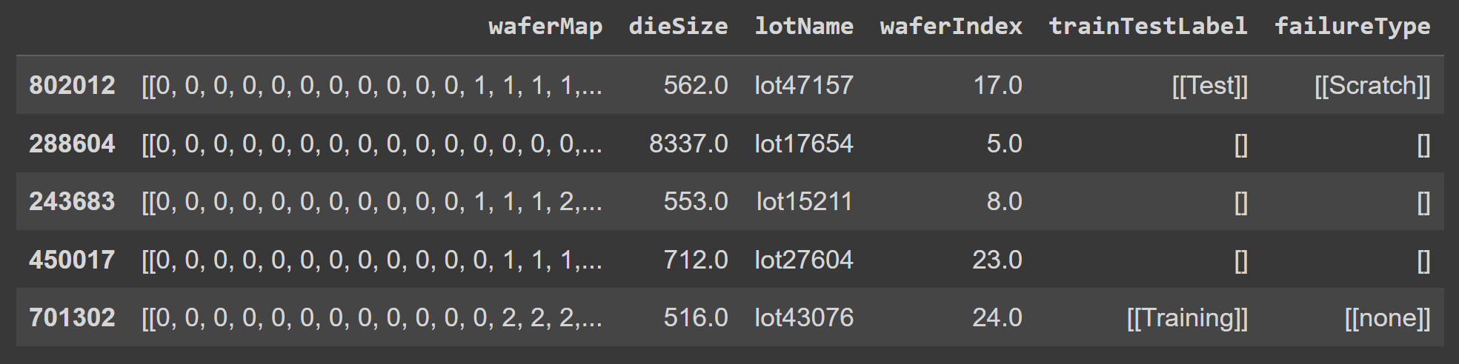
Exploratory Data Analysis.
811,457 rows by 6 columns
Column Names:
waferMap, dieSize, lotName, waferIndex, trainTestLabel, failureType
Notes:
Matt
First, the data that we were given from Kaggle was around eight hundred thousand rows by six columns
These columns are listed on the slide, but I’d like for us to focus on the failure type column on the right. That will be the label column that we will be creating our CNNs on.

Slide 10
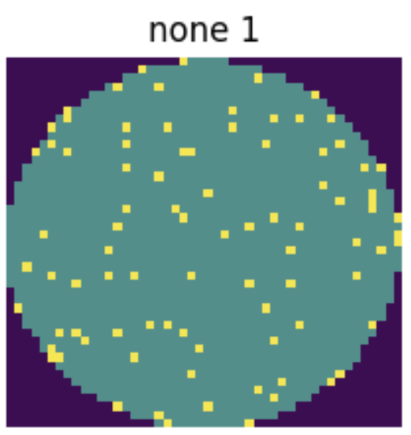
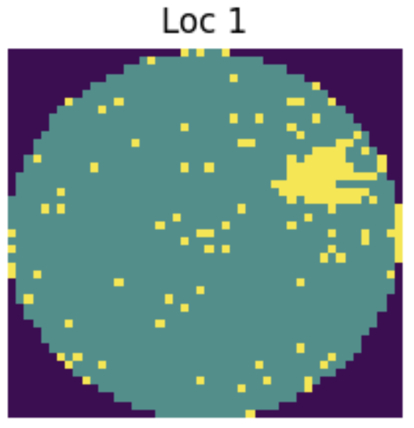
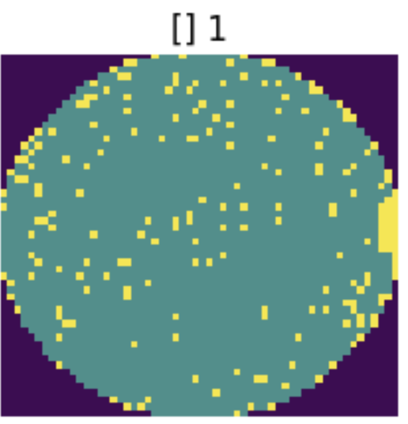
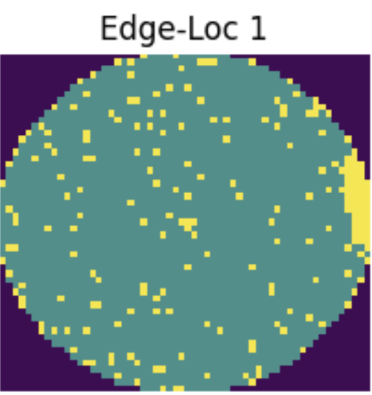
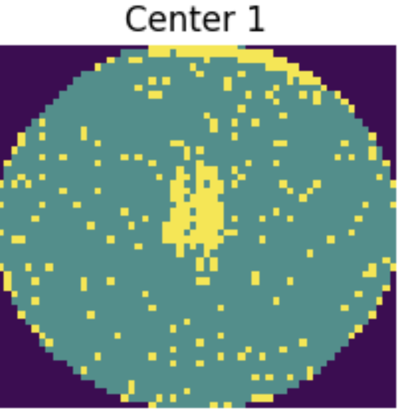
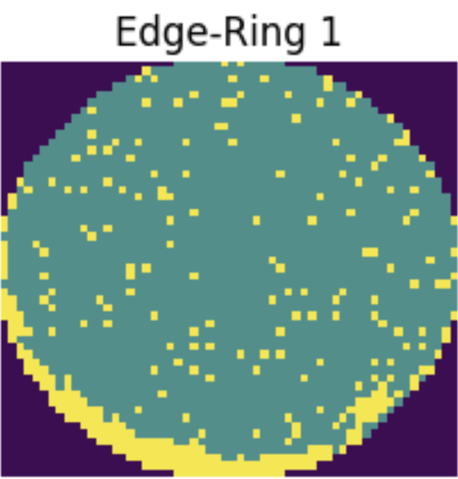
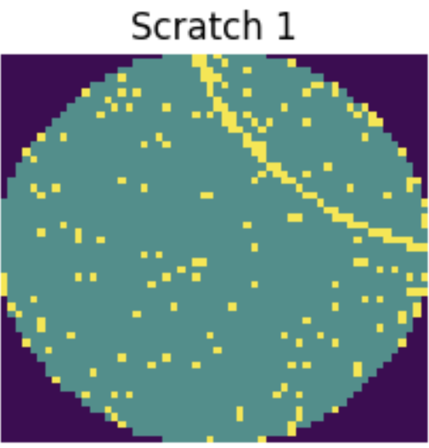
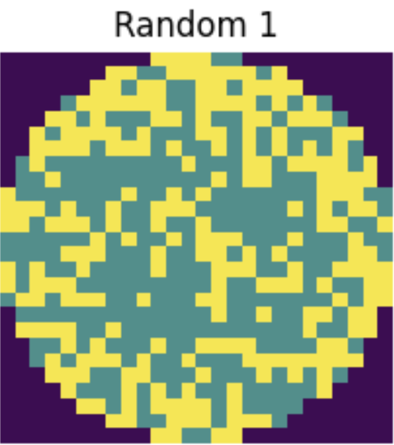
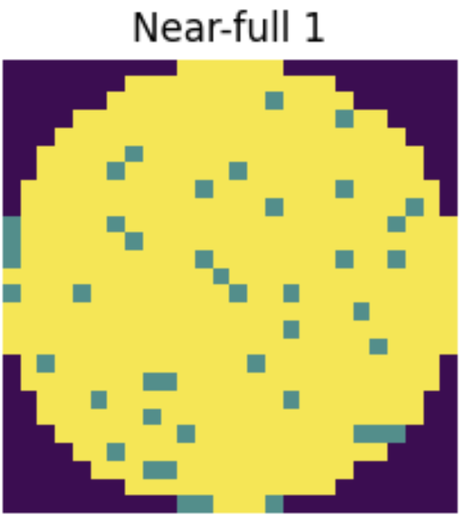
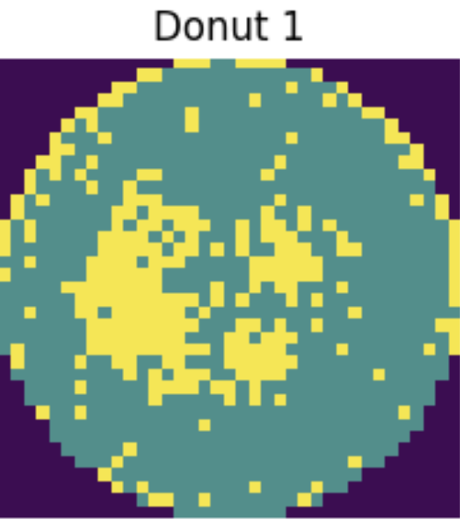
Exploratory Data Analysis.
Notes:
Matt
For our group, we needed to see how the images of the wafers looked. This allowed us to comprehend what the failure types looked like as well as help us understand the necessity of reshaping the images.

Slide 11
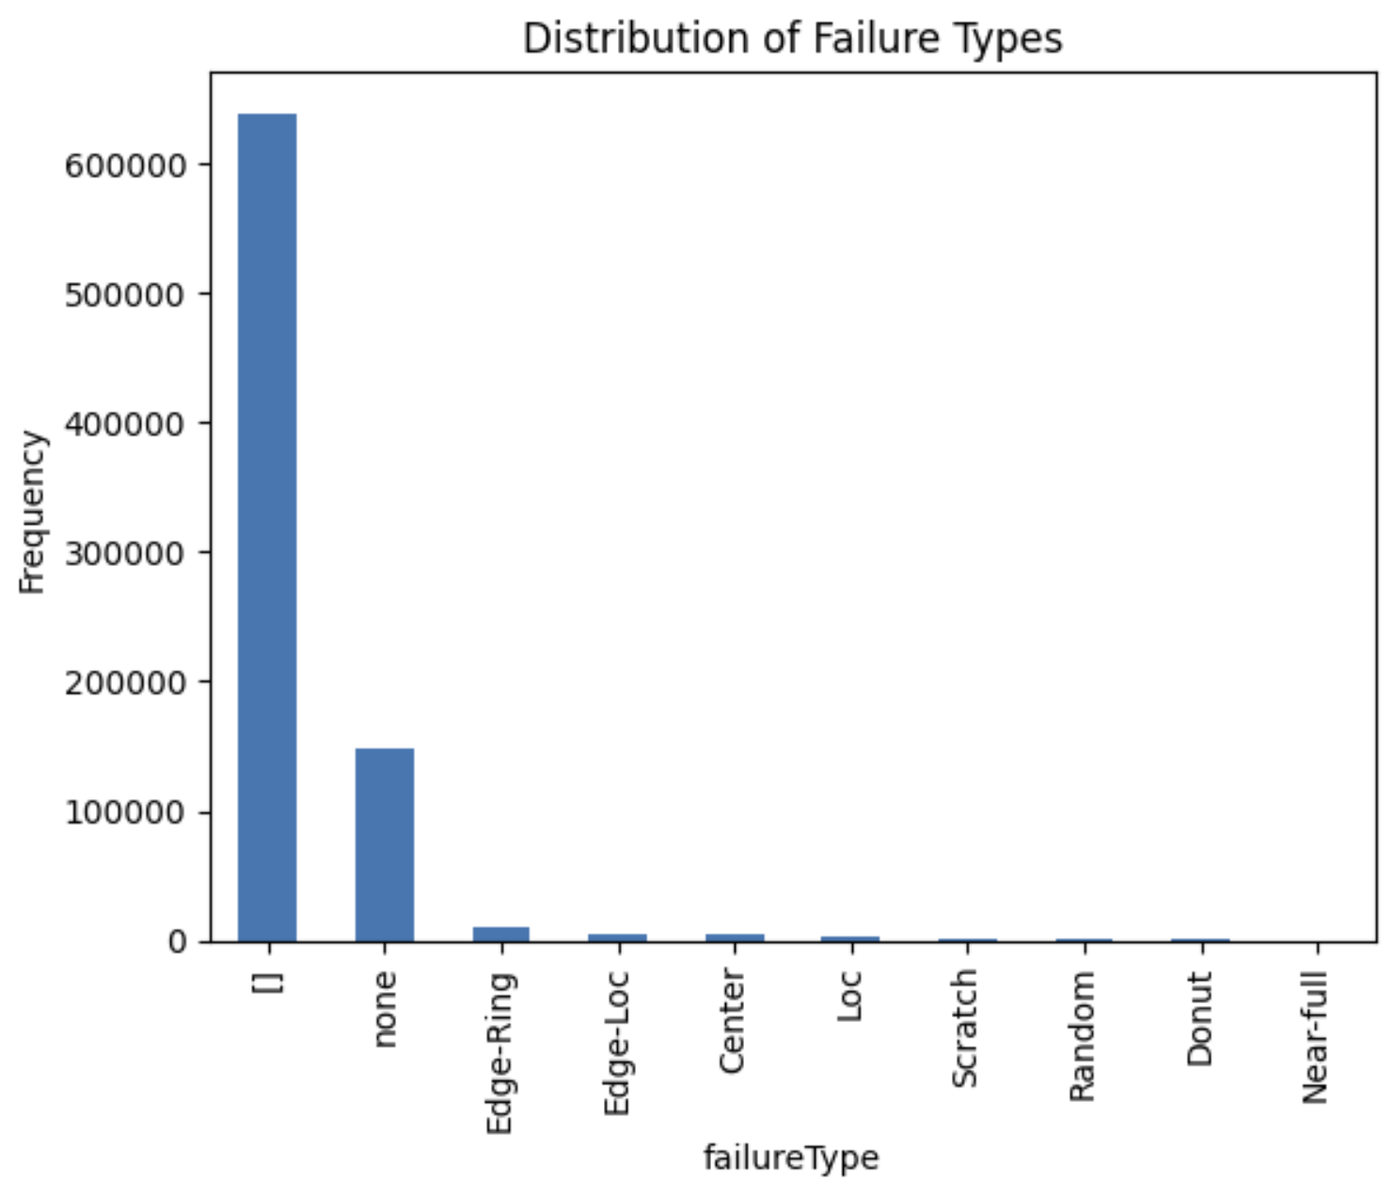
Exploratory Data Analysis.
Takeaways:
[] completely overshadows the failure types
Several failure types had very low value counts
Potential need to focus to specific failure types
Notes:
Matt
In this slide, on the right you can see the distribution of the failure types without any preprocessing. [] does not give us any useable label information which unfortunately is the most common label. Additionally, many of the failure counts had extremely low value counts which was a huge class imbalance. We will go over how we downselected the failure types to focus on in a later slide.

Slide 12
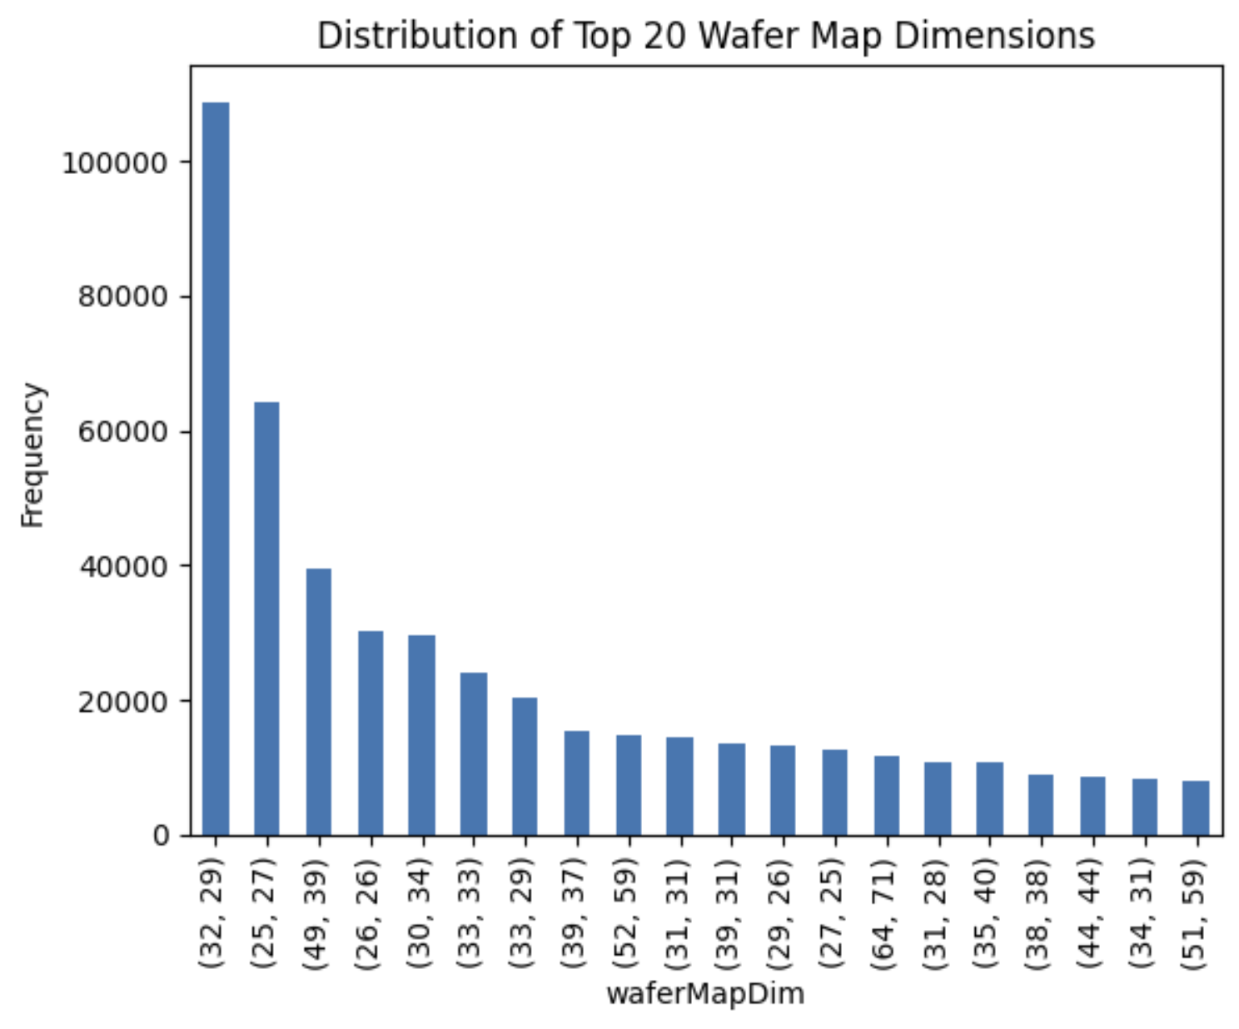
Exploratory Data Analysis.
Takeaways:
Wafer map dimensions vary and are not evenly distributed
Majority of sizes do not have the same X as Y pixel dimensions
Will likely need to consider reshaping
Notes:
Matt
Another important part of our EDA that we wanted to go into was the distribution of wafer map dimensions. We can see from the histogram on the right that there are many images with different dimensions, and the majority of those dimensions are not at a 1 to 1 scale. This showed that we would need to consider reshaping.
Now here is Akanksha to talk about our preprocessing procedures.

Slide 13
Data Preprocessing.
03
Notes:
Akanksha

Slide 14
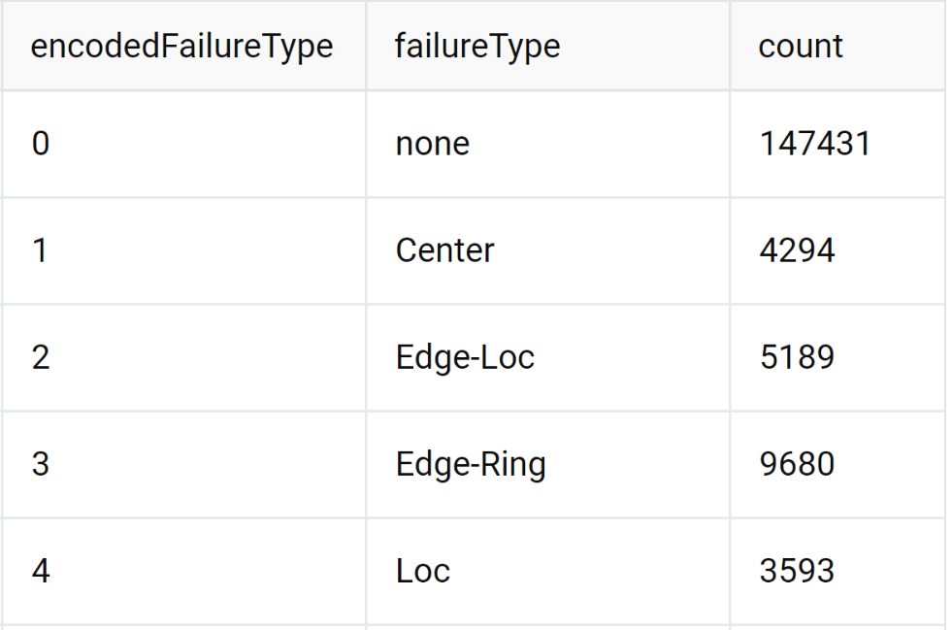
Preprocessing Procedure.
We are focusing on the images and failure type
Extracted text from brackets (“[[x]]”) for failure type
Narrowed the scope to 5 failure types due to severe imbalance
None, Edge-Ring, Edge-Loc, Center, Loc
Reshaped, resized wafer maps to (50, 50, 1) and normalized
cv2’s resize with interpolation INTER_NEAREST
Encode Failure Type labels
Preprocessed Data Size: 170,187 images
Preprocessed Data
Notes:
We are focusing on the images and failure type in this project. First, we cleaned up the failure type column, then we narrowed down to the five failure types that we want to analyze based on the other failure types having too few samples and forgoed the unknown failure type. We then reshaped, and resized our data so all our images of various dimensions have a uniform 50x50 dimension. In order to resize, we used cv2’s resize method with inter_nearest interpolation whose function resizes an image by assigning the nearest pixel value from the source to the destination. We also normalized the images by scaling the pixel values to have a zero mean and a variance of one . Then we encoded the failure type labels and you can see what the encodings correspond to in the table to the right. After completing the initial preprocessing steps, we have a little over 170k images. From the table to the right you can see that class imbalances still exist especially between none and the other failure types. We will talk about how we handled that shortly.

Slide 15
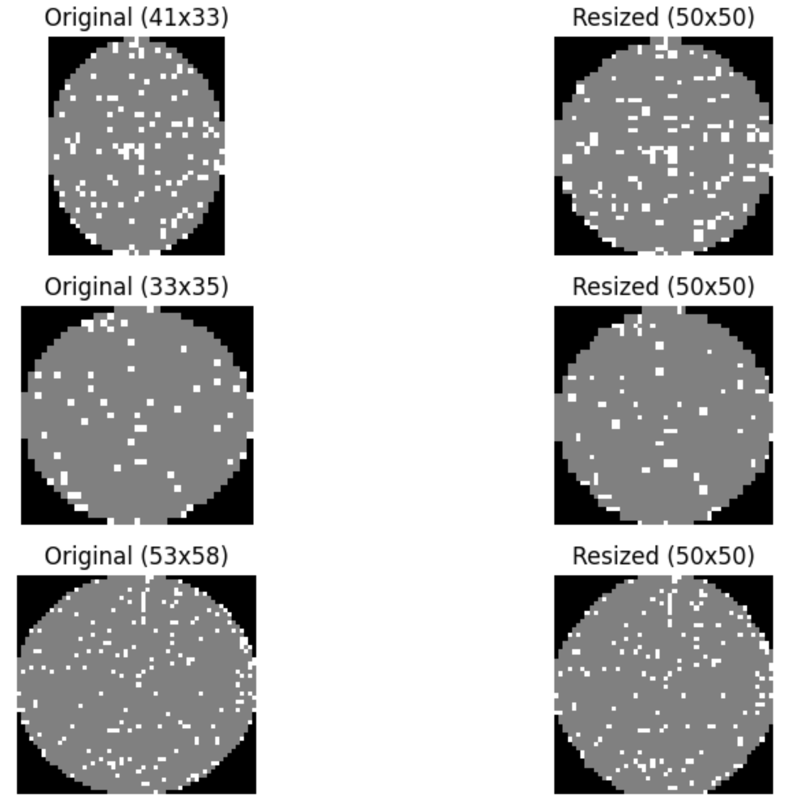
Resized Images
Notes:
This slide shows what images of various dimensions look like after they have been resized to have a uniform 50x50 dimension.

Slide 16
Dividing Data Into Train/Val/Test
Shuffled Data
Divided Dataset into a 60/20/20 train/val/test split
Training Data Distribution
None (0): 88417
Center (1): 2584
Edge-Loc (2): 3146
Edge-Ring (3): 5789
Loc (4): 2176
Notes:
After the initial preprocessing, we shuffled the data and divided it into a 60/20/20 split where the training set got 60% of the data and the validation set and test set got 20% each. We tried to tackle the class imbalances shown in the training data distribution with downsampling and data augmentation.

Slide 17
Downsampling and Augmenting
Downsample None (0) failure type from 88k to 6000
Augmented all other failure types till they achieved 6000 images each
Rotation
Width and Height Shifts
Flipping
Zooming
Notes:
We downsampled the None (0) failure type from 88k to 6000. This step prevents the model from being biased towards the majority class. Other failure types with fewer images were augmented to reach 6,000 images per class. We chose 6,000 as the standard sample size because the class with the second-highest number of images had slightly fewer than 6,000 images and all other classes had at least 2,000 images. This choice ensures that the standard is based on the existing distribution of data. The ImageDataGenerator was utilized for image augmentation. This process artificially increased the dataset size by applying transformations such as rotations, translations, zooming, and flipping.

Slide 18
Model Development.
04
Notes:
Alex

Slide 19
Baseline Model.
Objective:
To predict the majority class for all inputs, serving as a simple benchmark
Majority Class:
The baseline model predicts the majority class None (0) for every input
Performance Metrics:
Training Accuracy: The model achieves an accuracy of 86.59% on the training dataset
Validation Accuracy: The model achieves an accuracy of 86.78% on the validation data
Any model developed should aim to surpass this benchmark
Notes:
Akanksha
Our baseline model predicts the majority class None (0) for all inputs, achieving a training accuracy of 86.59% and a validation accuracy of 86.78%. This model serves as a simple benchmark to measure the performance of more complex models. Any advanced model should aim to exceed these accuracy metrics to demonstrate significant improvement.

Slide 20
Hyperparameter Tuning.
CNN Type | Kernel size | Layer change | Activation | Optimizer | Parameters | Training accuracy | Validation accuracy
Sequential | (3,3) |  | tanh | SGD | 389,125 | 0.237 | 0.057
Sequential | (3,3) | Activation | relu | SGD | 392,965 | 0.253 | 0.057
Sequential | (3,3) | Optimizer | relu | Adam | 1,178,897 | 0.712 | 0.916
Functional | (3,3) | CNN type | tanh | SGD | 144,519 | 0.200 | 0.057
Functional | (3,3) | Activation | relu | SGD | 144,519 | 0.200 | 0.057
Functional | (3,3) | Optimizer | relu | Adam | 433,553 | 0.613 | 0.865
Functional | (5,5) | Kernel size | relu | Adam | 819,089 | 0.702 | 0.908
Functional | (5,5) | Add dropout | relu | Adam | 819,089 | 0.862 | 0.952
Notes:
Alex
In our hyperparameter tuning, we elected to use this table to guide our experimentation. In the first column, you can see that we started with a Sequential CNN model, tuned hyperparameters there, and then moved over to a Functional CNN model and continued tuning. The hyperparameters we experimented with were kernel size, activation types, optimizers, and regularization techniques. For kernel sizes, we moved from a (3,3) kernel to a (5,5) kernel and saw slight improvement in the functional model. We also saw slight improvements in the sequential model moving from a “tanh” activation to a ReLU activation (but not in the functional model). The largest difference we saw was in changing the optimizer from a stochastic gradient descent optimizer to an Adam optimizer. Then we saw another bump in accuracy by adding a dropout layer, which brought us to our final model.

Slide 21
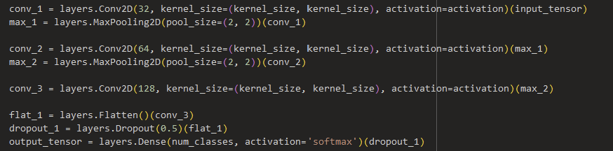
Advanced Model.
Architecture.
Hyperparameters.
Results.
Activation of “ReLU”
Adam optimizer
Kernel size of (5,5)
Addition of dropout layer with p=0.5
Train Accuracy: 0.862
Validation Accuracy: 0.952
Test Accuracy: 0.953
Functional Convolutional Neural Network (CNN) model
Notes:
Alex
For our final model, we ended up with a Functional Convolutional Neural Network with 3 Conv2D layers interspersed with 2 MaxPooling2D layers, before finishing it off by Flattening it, adding a Dropout layer, then a Dense fully-connected layer using a softmax activation. For our parameters, we used a ReLU activation, an Adam optimizer, a Kernel size of (5,5), and we also saw improvement with the addition of the dropout layer to randomly drop a number of hidden units at every iteration at a probability rate of 0.5. This ensures the model can’t rely on the activation of any given set of units, causing it to create redundancies and giving us a more robust model.
We ended up with a testing accuracy of 0.862, a validation accuracy of 0.952, and a test accuracy of 0.953.

Slide 22
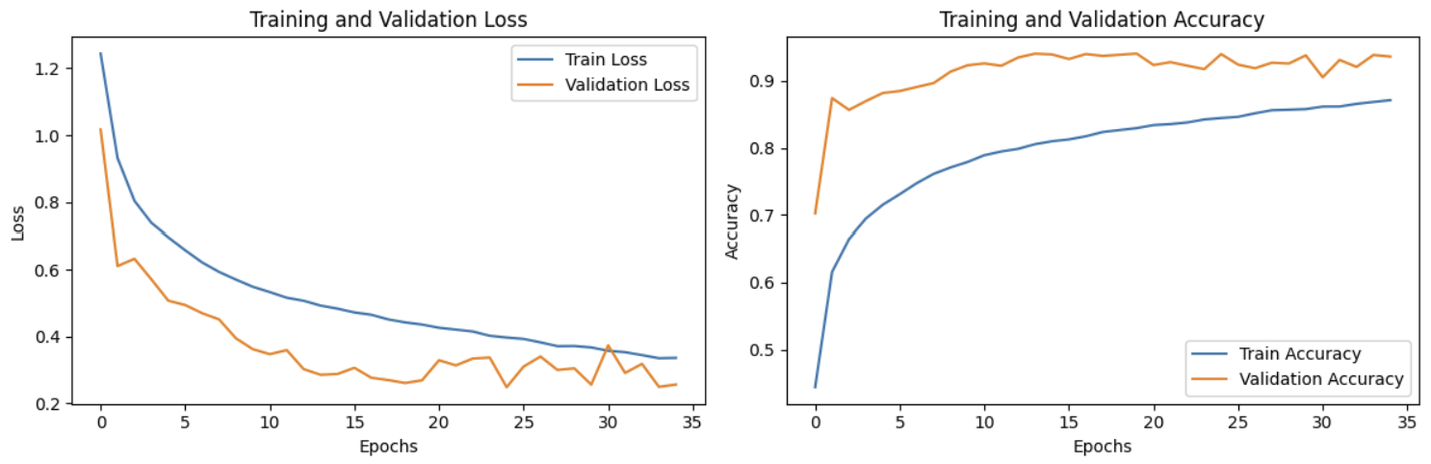
Loss and Accuracy.
Notes:
Alex
We let the model run for 50 epochs, using an early stopping callback. As you can see from the charts describing the training and validation losses and accuracies, the metrics leveled out around 35 epochs. And you can also see that our validation accuracy is consistently higher than the training accuracy, this concerned us a bit but after some further research we learned that this is a normal side effect of using dropout and possibly also a degree of noise in our training set.

Slide 23
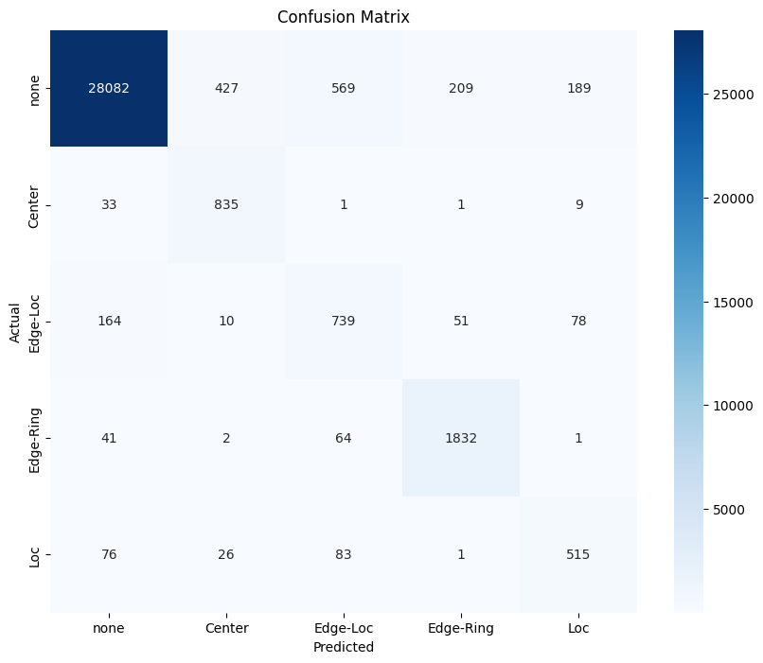
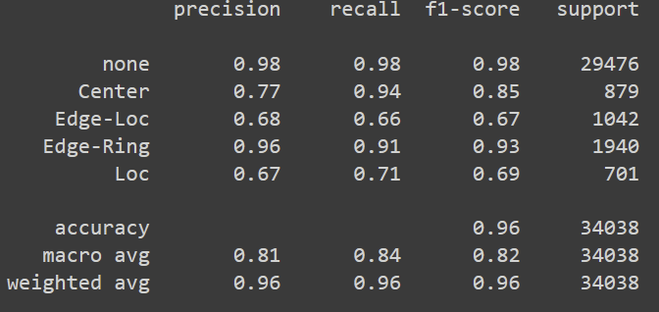
Confusion Matrix.
Notes:
Alex
Here is our confusion matrix. As you can see from the numbers along the diagonal, there were many more labels correctly predicted as the correct label than the incorrect label.
Overall, we were happy with the results. You can see some classes more difficulty than others, notably the Loc and Edge-Loc classes. But in our classification report which you can see to the left, we observed good rates of precision, recall, and macro averages overall, and a very high accuracy at 0.96.

Slide 24
Conclusion.
Took learnings from EDA to narrow scope
Resized wafer map to utilize full dataset
Downsampled and upsampled data to resolve class imbalance
Applied multiple augmentation methods
Ran several CNN models compared to the baseline model to achieve a 8.52% improvement!
Baseline Model Accuracy: 86.78%
Advanced Model Accuracy: 95.3%
Notes:
Matthew
Thank you to Alexandra for the explanation of our models. Overall in this project, we performed EDA to understand the limitations of our dataset. Then we preprocessed accordingly by only using data that was within our narrowed scope, which included dimension resizing, downsampling, and applying multiple augmentation methods. Finally, we ran several CNN models to achieve a final accuracy of 95.3%

Slide 25
Avenues for Future Work
Investigate how all failure types can be included in the classification
Try fine tuning a pre-trained model for classification
Build a model with a larger capacity
Try more advanced data augmentation:
Gaussian Noise: Adding random noise to the image
Blurring
Random Erasing
Notes:
Matt
For future avenues of work, we can investigate ways to ensure all failure types are represented, and explore fine-tuning pre-trained models for improved classification. Given more time and increased resources, future work could include producing a model with a higher capacity by increasing parameters. A model like this was built, using additional layers, a KerasClassifier, and the KFold technique, but we lacked the adequate time and processing power to train it.
Additionally, we can experiment with advanced data augmentation techniques such as gaussian noise, blurring, and random erasing to create more robust and diverse images.

Slide 26
Thank you!
Do you have any questions?
See our project notebooks here: Google Drive
Notes:
Matt
If you’d like to review our notebooks, here is the link to our Google Drive.
Are there any final questions?
https://drive.google.com/drive/u/0/folders/1ocI6PXbdOnOndN1iRujXDhd-iAN3vcp5

Slide 27
Contributions
Akanksha - Initial analysis, data preprocessing, development of base model
Alexandra - Advanced model experimentation, presentation design
Matthew - Experimentation and conclusions
Maximillian - Data preprocessing and development of baseline model

